Slide 1
Comparison of Lab Data to in situ dataSONDE Measurements
Elinor Sauer and Dr. Hilairy Hartnett
School of Earth and Space Exploration

Slide 2
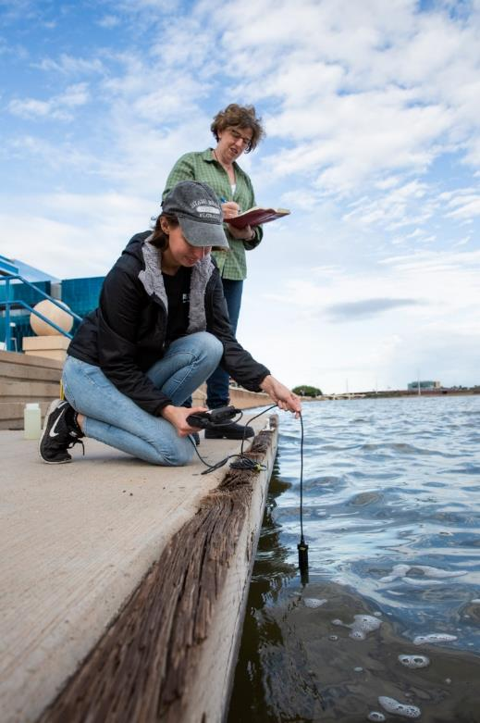
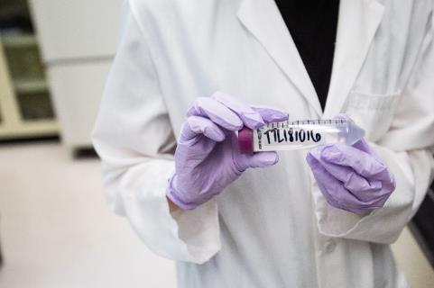

Introduction
Tempe Town Lake (TTL)
Things I Measure:
pH
Dissolved Oxygen
Conductivity
Dissolved Organic Carbon
UV and Fluorescence
The Hartnett lab has monitored TTL water chemistry and dissolved carbon since 2005
For the past year, I have sampled TTL twice a week
A new DataSONDE has also been collecting in situ data for one year
My project compares lab results with in situ data from the SONDE
A filtered TTL sample ready for fluorescence analysis
Elinor Sauer and Dr. Hartnett gathering data at TTL

Slide 3
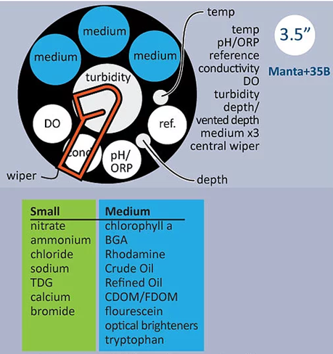
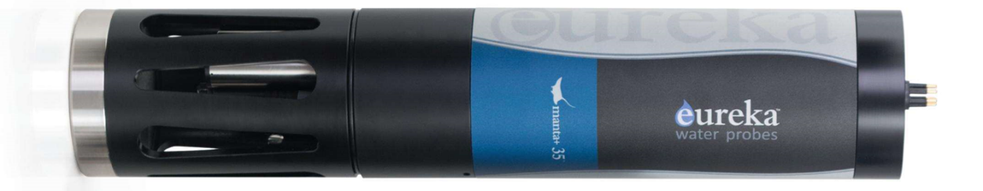


Background
SONDE
Background
Data SONDE
The SONDE measures pH, Dissolved Oxygen, Conductivity, and fluorescent Dissolved Organic Carbon
  the same parameters I measure each week
Collects data every 30 minutes
Monthly data retrieval and SONDE maintenance

Slide 4
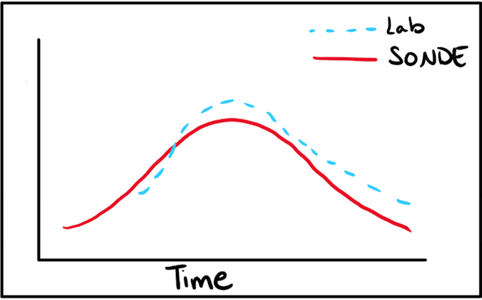
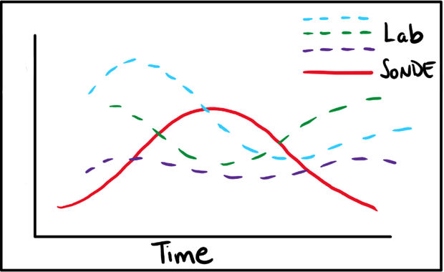
The Question
The Big Question
Is the SONDE data consistent with the lab measurements?
We have to know this if we are to rely on its data
If they are not, I expect differences between the lab data and the SONDE data:
If they are, I expect to see something like:

Slide 5
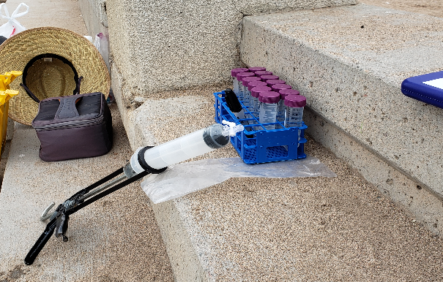
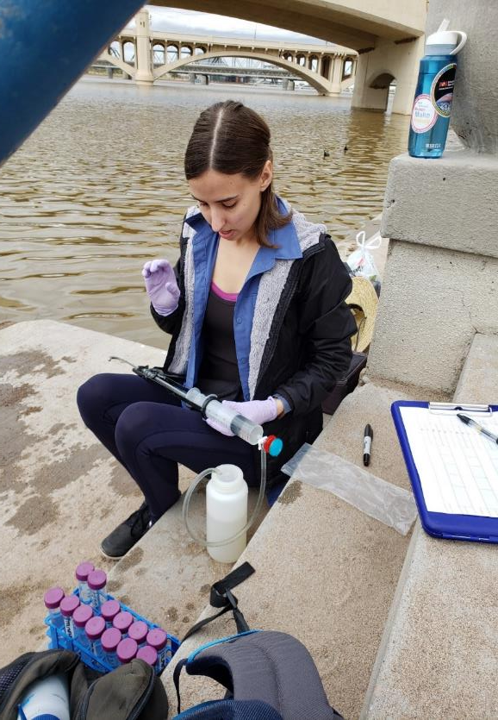
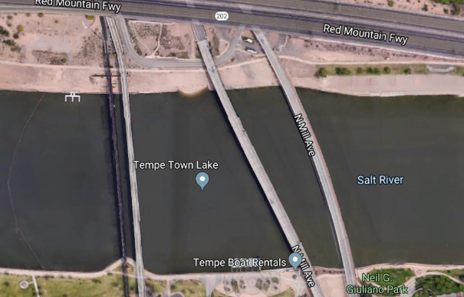


Methods
Methods
Day 1: Every 30 minutes
3/8/19
Collect samples every 30 minutes for 4 hours
Filter and acidify in situ
Focus on Fluorescence
  Run through machine in lab
No time to do DO, conductivity, temperature or pH
Compare with dataSONDE!

Slide 6
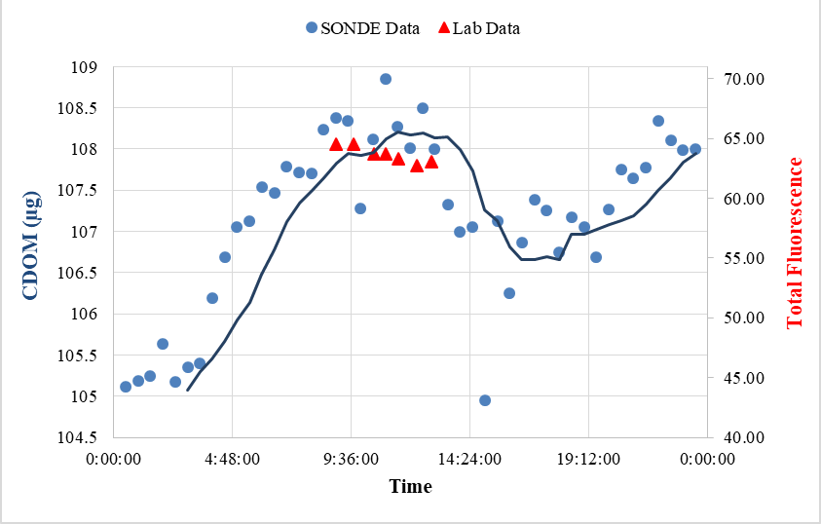
Data
Fluorescence from Lab
Data Comparison
Day 1: Fluorescence Comparison
Total Fluorescence is the sum of all the intensity in the EEM, used to approximate dissolved organic carbon (my data)
CDOM is colored dissolved organic matter, used to approximate dissolved organic carbon (SONDE data)
Scale is not the same, but the patterns resemble each other

Slide 7
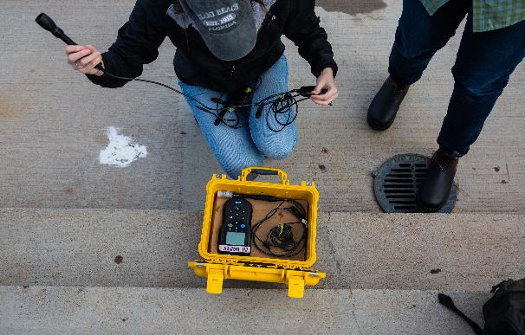
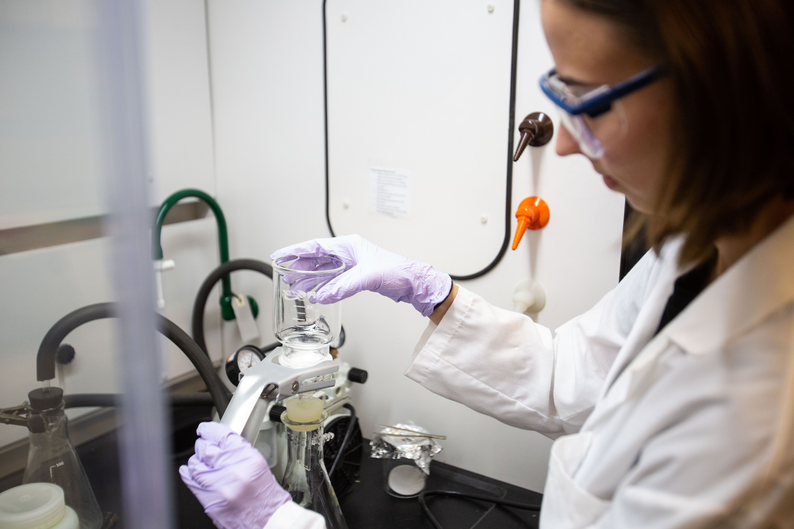
Methods
Methods
Day 2: Every 2 hours
8/11/19
Collect samples every 2 hours for 14 hours
Filter and acidify in the lab
Measure fluorescence
  Run through machine in lab
Measure DO, conductivity, temperature and pH at in situ
Compare with dataSONDE!

Slide 8
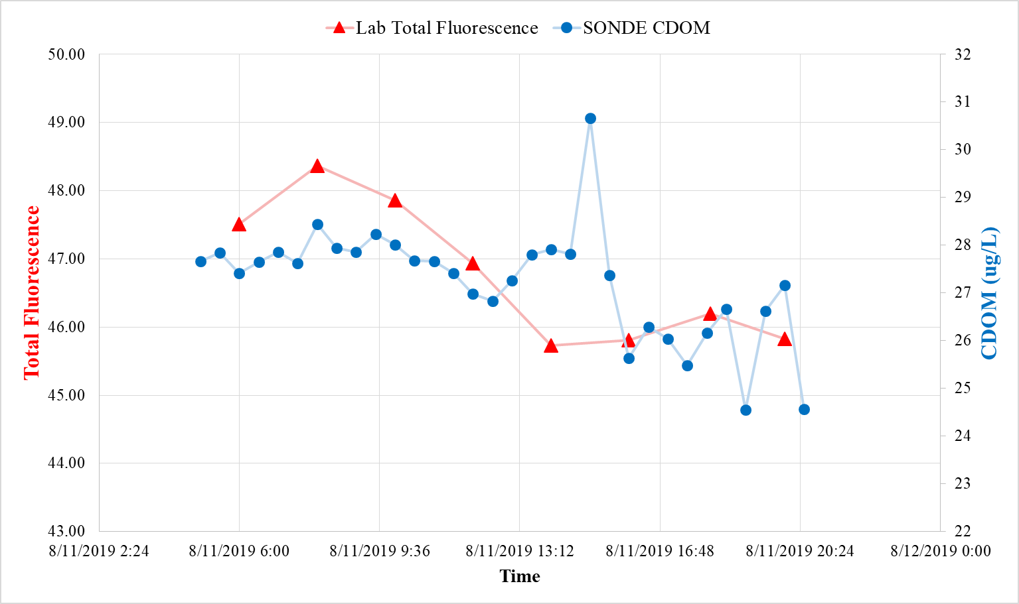
Data
Fluorescence from Lab
Data Comparison
Day 2: Fluorescence Comparison
Total Fluorescence is the sum of all the intensity in the EEM, used to approximate dissolved organic carbon (my data)
CDOM is colored dissolved organic matter, used to approximate dissolved organic carbon (SONDE data)
Again, scale is difficult to match
We see overall similarities in trend, with some outliers

Slide 9
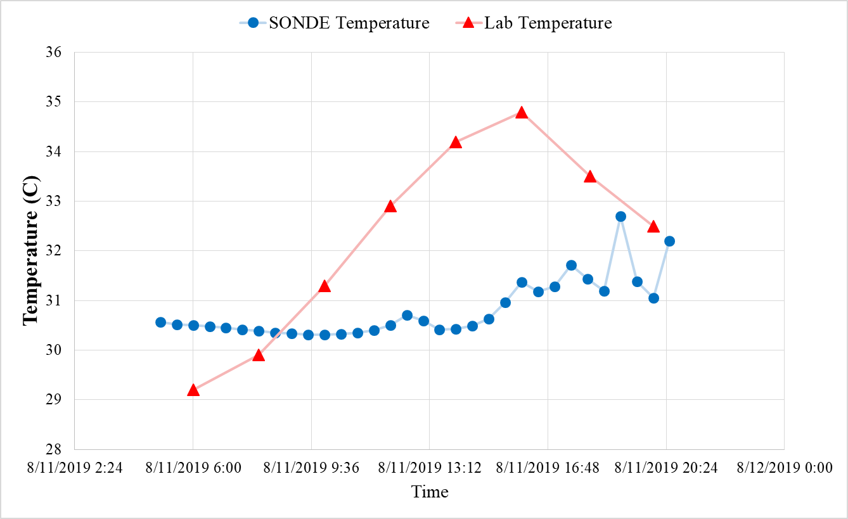
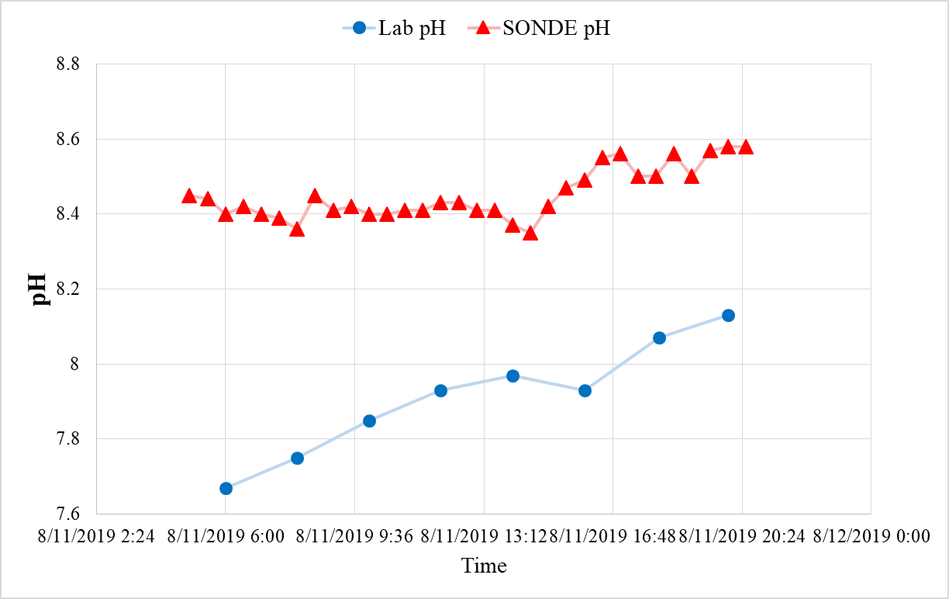
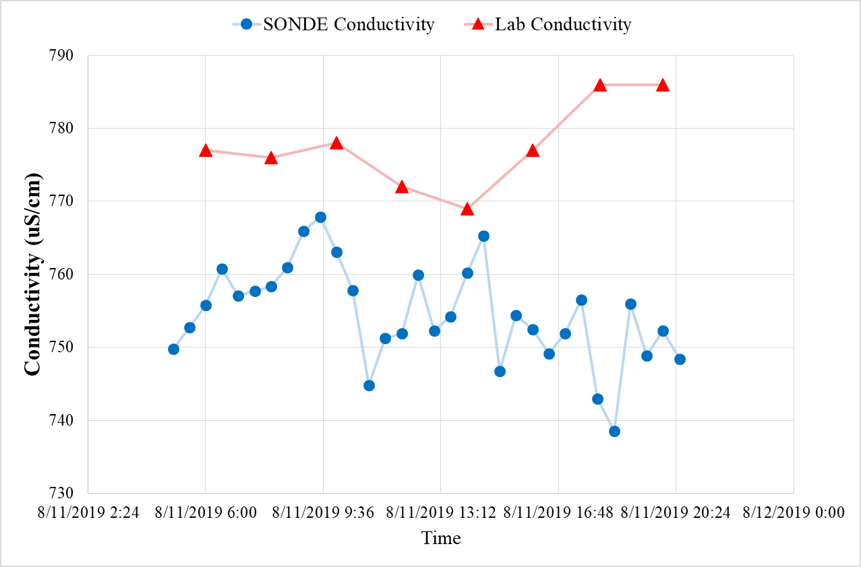
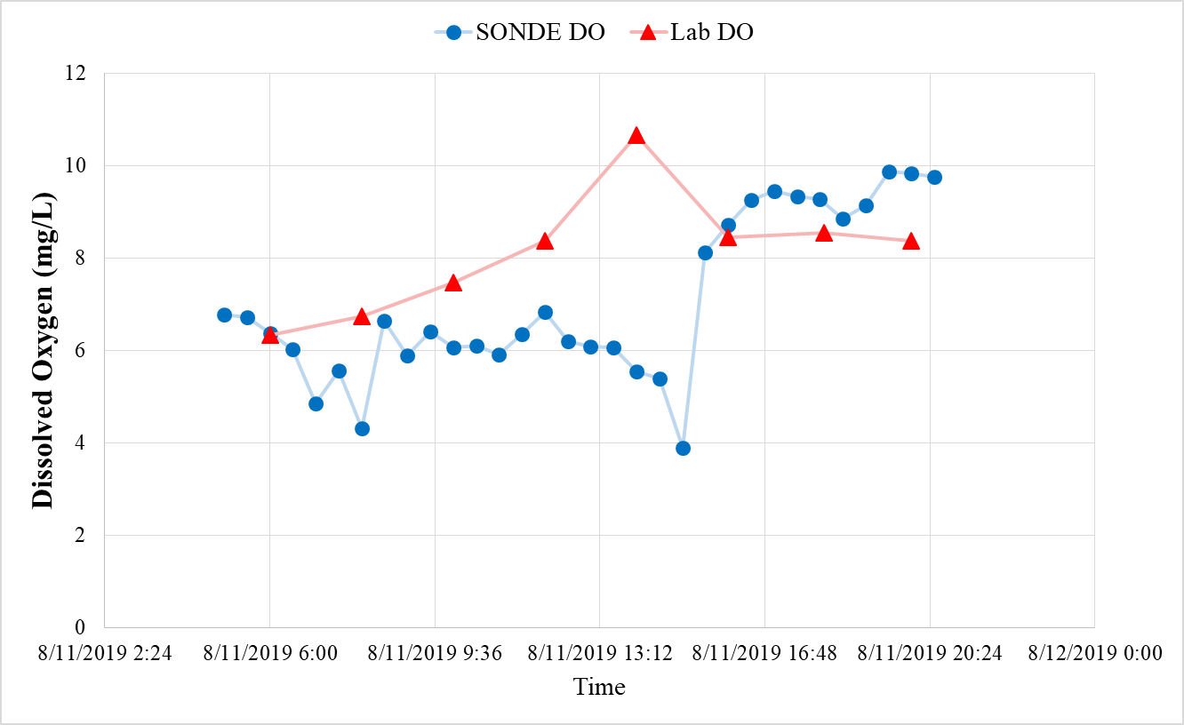
Data
Fluorescence from Lab
Data Comparison
Day 2: Four Other Measurements
Fig 1. Temperature Comparison (Left)
Fig 2. pH Comparison (Left)
Fig 4. Dissolved Oxygen (Left)
Fig 3. Conductivity Comparison (Left)

Slide 10
Data
Fluorescence from Lab
Conclusions, Implications, and Future Plans
  Total Fluorescence and SONDE CDOM patterns are consistent
      CDOM is a good proxy for fluorescent carbon
  There is some variation in measurements for temperature, conductivity, pH and DO
    Perhaps time scale is too short to align properly? Or differences with calibration?
New questions:
  Do the patterns align better over longer time spans?
  Do CDOM and total Fluorescence really reflect carbon concentration?
Next steps:
Compare the historical lab data to historical SONDE data
Measure total carbon concentrations using DOC
Thank you to Josh Nye for help with the modelling, Tessa Fisher for SONDE data and Donald Glaser for sampling assistance!

